Slide 1



Marketing Mix Regressions
Notes:
Thanks for inviting me. It has been great meeting and getting to know everyone. I am going to present this research study that is part of a new stream whose main objective is to obtain a better understanding of the role of attitudes on invidividual customer profitability.
In this study we look at two things; (1) he role of customer attitudes on the relationship between sales calls and sales at the invidual customer level, and (2) the role of competitors in this context.
Roland’s work on customer equity was the first to propose using customer surveys to measure customer equity…here we are assessing the value of combining longitudinal customer survey panels with corresponding longitudinal customer transaction histories.

Slide 2
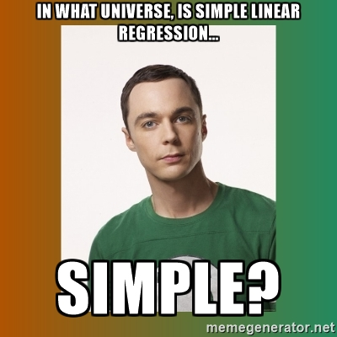

Slide 3
Introduction
Regression is an important part of an analytics tool kit.
It allows us to understand if two variables are related to each other.
In this session we will
Understand how to interpret regression outputs
Understand confounding effects and the biases introduced by missing variables

Slide 4

Class Rating

Slide 5
Diagnosing Market Response: Regression Analysis

Slide 6
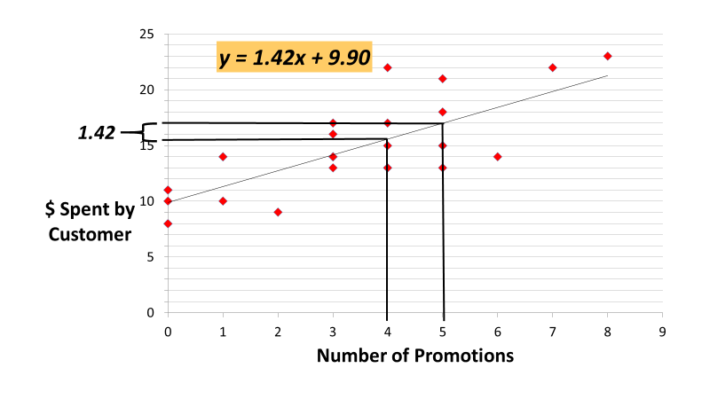

Slide 7
Diagnosing Market Response: Regression Analysis
Regression Statistics
R-Squared | 0.601
Adjusted R-Squared | 0.586
ANOVA
 | df | SS | MS | F | Sig F
Regression | 1 | 267.28 | 267.28 | 40.60 | 0.00
Residual | 27 | 177.75 | 6.58
Total | 28 | 445.03
 | Coefficients | Standard Error | t Stat | P-value
Intercept | 9.90 | 0.85 | 11.60 | 0.00
Number of Promotions | 1.42 | 0.22 | 6.37 | 0.00

Slide 8


Slide 9
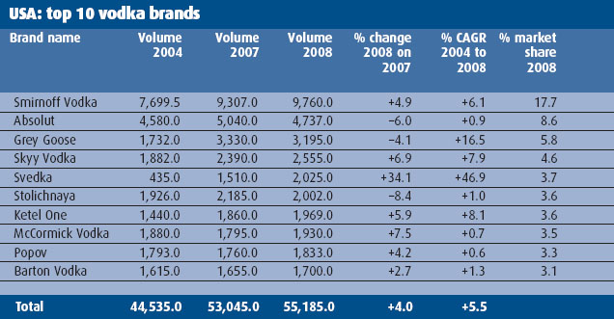
The Best Sellers

Slide 10

Print Ads

Slide 11
Marketing Analytics?
Optimization
“What’s the best that can happen?”
Predictive and Prescriptive Analytics
(the “so what”)
Predictive Modeling
“What will happen next?”
Randomized Testing
“What if we try this?”
Degree
of
Intelligence
Statistical Analysis
“Why is this happening?”
Alerts
“What actions are needed?”
Query/drill down
“What exactly is the problem?”
Descriptive Analytics
(the “what”)
Ad hoc reports
“How many, how often, where?”
Standard Reports
“What happened?”
Metrics, Then Analytics!
Source: Thomas Davenport, Competing on Analytics, 2007

Slide 12
Marketing Mix Models - Predictive
 |  |  | Advertising
Regression Characteristic | Lag Sales | Price | Print | Broadcast | Outdoor | Adj. R2
Unit Sales (predictive) | 0.92 | -0.085 | 0.02 | 0.01 | -0.007 | 0.98
Ln (Sales (t) +1 ) = b0 + b1 * Sales (t)+ b2 * Price (t+1)+
b3*Print(t+1) + b4 * Broadcast(t+1) +
b4* outdoor(t+1) + error

Slide 13
Marketing Mix Models - Predictive
 | Coefficient | P-value
Intercept | .86 | <.01
lnPrice | -0.085 | <.01
lnOut | -.0072 | .18
Lnbroad | .01 | .06
Lnprint | .024 | <.01
Lnlsales | .92 | <.01
R-Square | .98
 | Coefficient | P-value
Intercept | .41 | <.01
lnPrice
lnOut
Lnbroad
Lnprint
Lnlsales | .95 | <.01
R-Square | .977
98% of variance in sales this year is explained by sales last year

Slide 14
Except Grey Goose No Brand Changes Tier

Slide 15
Change in Sales is More Relevant

Slide 16
Unit Roots in Predictive Models
Common in data that:
spans long time periods
is aggregated across units (customers, stores etc)
Y (t) = b0 + Y(t-1) + error
Sales in time t is equal to sales last year plus error
Random noise or error is the only thing that determines how sales progresses over years.
But can this model help change sales using marketing?

Slide 17
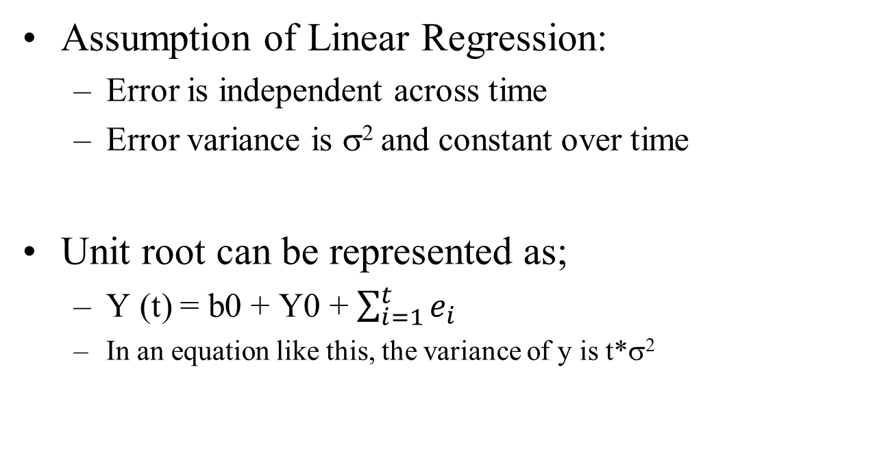
Unit Roots in Predictive Models
Assumption of Linear Regression:
Error is independent across time
Error variance is σ² and constant over time
Unit root can be represented as;
Y (t) = b0 + Y0 + $\sum_{i=1}^{t}{e_{i}}$
In an equation like this, the variance of y is t*σ²

Slide 18
Prescriptive Models – Predicting Change in Sales?
 |  |  | Advertising
Regression Characteristic | Lag Sales | Price | Print | Broadcast | Outdoor | Adj. R2
Only Marketing Mix | -- | -0.002 | 0.019 | -0.005 | -0.013 | 0.10
Add Brand Tier | -- | -0.04 | 0.011 | -0.006 | -0.014 | 0.11
Add Competition and lag market share | -- | -0.064 | 0.015 | -0.002 | -0.008 | 0.23
Add New Product Intro | -- | -.092 | .016 | .003 | -.010 | 0.37
Y(t)-Y(t-1) = b0 + b1*price (t-1) + b2*print (t-1) + b3 * broadcast (t-1)+…

Slide 19
Prescriptive Models – Why are Price coefficients changing?
 |  |  | Advertising
Regression Characteristic | Lag Sales | Price | Print | Broadcast | Outdoor | Adj. R2
Only Marketing Mix | -- | -0.002 | 0.019 | -0.005 | -0.013 | 0.10
Add Brand Tier | -- | -0.04 | 0.011 | -0.006 | -0.014 | 0.11
Add Competition and lag market share | -- | -0.064 | 0.015 | -0.002 | -0.008 | 0.23
Add New Product Intro | -- | -.092 | .016 | .003 | -.010 | 0.37

Slide 20
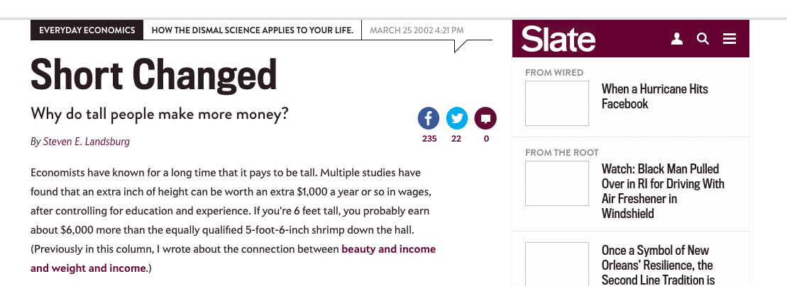

Slide 21
Survey of Adult Americans (1994)
Earnings - $s
Height – inches
Sex: 1 = men, 2 = female

Slide 22
Height
Income
5’10”
$100K
Does height cause income?
5’4”
$80K
5’11”
$120K
5’3”
$75K

Slide 23


Height
Income
5’10”
$100K
Does height cause income?
5’4”
$80K
5’11”
$120K
5’3”
$75K

Slide 24
Height
Gender
Income
5’10”
Male
$100K
Does gender or height cause income?
5’11”
Male
$120K
5’4”
Female
$80K
5’3”
Female
$75K

Slide 25
Earnings = f(height)
Earnings = f(height, Male)
Regression Statistics
Multiple R | 0.09
Observations | 1192
Regression Statistics
Multiple R | .09
Observations | 1192
 | Coefficients | P-value
Intercept | -61,316 | <.01
Height | 1262 | <.01
 | Coefficients | P-value
Intercept | -10,334 | .98
Height | 443 | .02
Male | 9088 | <.01

Slide 26
Omitted Variable Bias
Z
(Brand Tier)
+
+
Y
(Change in Sales)
X
(Price)
-

Slide 27
Takeaways

Slide 28
Why are the coefficients on advertising sometimes positive, negative or non-significant?
 |  |  | Advertising
Regression Characteristic | Lag Sales | Price | Print | Broadcast | Outdoor | Adj. R2
Change in Sales | -- | -0.002 | 0.019 | -0.005 | -0.013 | 0.10
Add Brand Tier | -- | -0.04 | 0.011 | -0.006 | -0.014 | 0.11
Add Competition and lag market share | -- | -0.064 | 0.015 | -0.002 | -0.008 | 0.23
Add New Product Intro | -- | -.092 | .016 | .003 | -.010 | 0.37

Slide 29
Print and Outdoor Advertising
 | Outdoor | Print
Outdoor | 1
Print | 0.53 | 1
 |  | Advertising
Regression Characteristic | Price | Print & Outdoor | Adj. R2
Print & Outdoor | -0.04 | 0.005 | 0.13

Slide 30


Slide 31
Omitted Variable Bias
+/-
Coefficient Value
Multicollinearity
Coefficient Standard Error
+

Slide 32
Omitted Variable Bias
Z
(Male)
+
+
Y
(Earnings)
X
(Height)
+

Slide 33
Multicollinearity
Regression relies on the unique variation of x variables to affect y
When x and another variable (K) are correlated, the unique variation of x is reduced
The variation of x after removing the correlation in k, or the variation that is unique to x and not part of its correlation with k is less.
Think of this as regressing x on K first, then take the residuals (e)and then run a regression of y on the residual, e.
Earnings, gender, height
Height <- Gender + error
Earnings <- error
This lower unique variation implies that the there is more noise in the relationship between x and y, so the standard error is higher

Slide 34
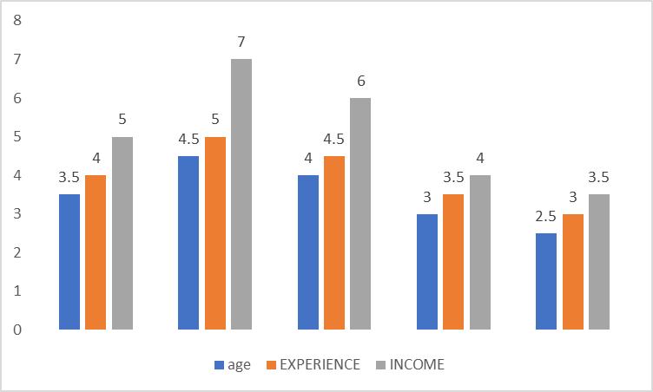
When is the relationship between experience and earnings easier to find?
A
B

Slide 35
Consider two regressions
D.V. is Earnings
D.V. is Earnings
 | Coefficients | S.E. | P-value
Intercept | -1.056 | .0757 | <.01
Education | .116 | .005 | <.01
Experience | .011 | .008 | <.01
Female | -.254 | .022 | <.01
 | Coefficients | S.E. | P-value
Intercept | -1.37 | .672 | .04
Education | .169 | .111 | .129
Experience | .063 | .111 | .569
Female | -.254 | .022 | <.01
Age | -.0524 | .113 | .63
Age is correlated with Education and Experience
But Age does not affect Earnings

Slide 36
How to deal with Multicollinearity?
If the problem variable (k);
does not affect y, remove it from the regression.
Affects y, and can be combined with x (e.g., print and outdoor advertising) combine the two
Variance Inflation Factor (VIF) will let us the extent to which multicollinearity is a problem.

Slide 37
Coming Attractions
In 48 Hours
Submit the project proposal
Next Week
Customer Lifetime Value
Connection between CLV and Shareholder Value

Slide 38
Marketing Mix Models - Summary
High R-Squares can be misleading
High R-square are important for predictive analytics
Change in sales better than level of sales for marketing strategy
Evaluate relationships among the independent variables
Omitted variables, multicollinearity

Slide 39
Marketing Mix Models - Summary
Are independent variables correlated?
Is the sign of a variable not making sense?
Is the significance and sign of the coefficient changing with other variables in the model?
E.g., Outdoor advertising
Do we have an omitted variable bias?
E.g., Price coefficient when we added brand tier
If no omitted variable bias-
Check for correlation among independent variables
If they are correlated; try combining them (add/subtract/divide/multiply etc.) or remove one of the variables

